Slide 1


Great Lakes Region V
Regional Meeting
NACADA Annual Conference
October 9, 2014
Minneapolis, MN

Slide 2
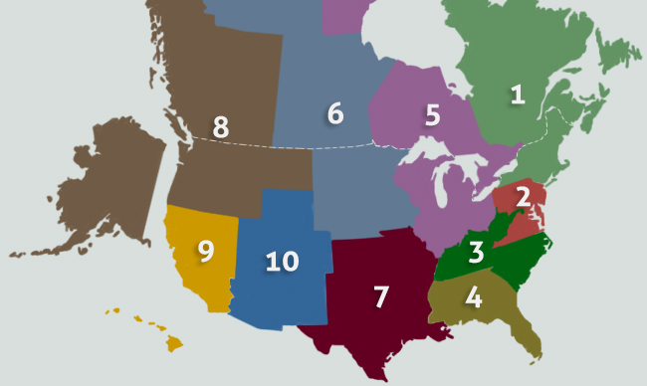
Great Lakes Region V

Slide 3
Region V Steering Committee
2013-14
Deb Dotterer, Chair
Brody Broshears, Past Chair
Tom Owens, Michigan
Theresa Hitchcock, Indiana, Conference Co-Chair
Teri Farr, Illinois
Jeanette Berger, Ohio
Jo Stewart, Ontario
Angela Swenson-Holzinger, Wisconsin
Joshua Morrison, Conference Co-Chair

Slide 4
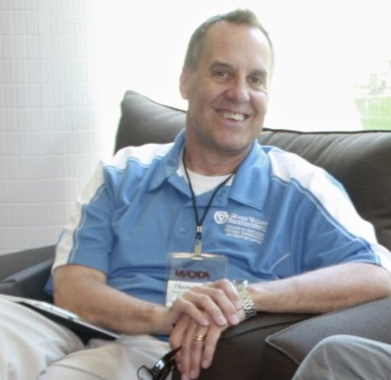

HAPPY BIRTHDAY Tom and Brody!!!

Slide 5
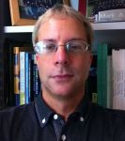

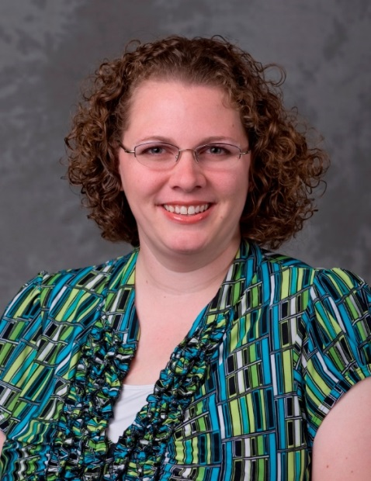

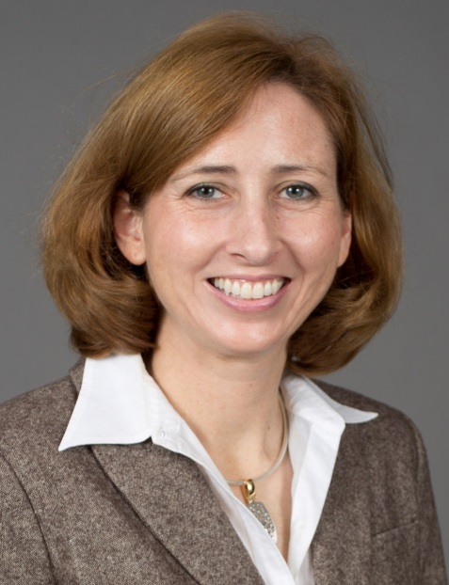

Incoming Steering Committee Members
2014-16

Slide 6
Facts About Region V
Region V is the largest of the 10 regions!
Over 1600 members strong!
Awarded over $7000.00 in grants and scholarships to our members!
Broke regional conference attendance record at 2014 conference with over 500 participants!

Slide 7
2014 Goals
Develop and Sustain Effective Regional Leadership
    Had 3 or more candidates run for Liaison Positions
    Was able to fill two mid term vacancies.
    Confirmed co-chairs for 2016 Regional Conference in Ontario
    Created Crossing Borders Grant to enhance participation in Province and State meetings by those not residing in the areas.

Slide 8
2014 Goals
Engage in Ongoing assessment of all facets of the Association.
  Developed survey questions and will distribute survey to all
  grants and scholarship awardees to assess effectiveness of
  the program.
Pursue innovative technology tools & resources to support the Association.
Actively utilized Facebook and Twitter
during Regional Conference and are striving to increase
usage between conferences.

Slide 9
Grants and Scholarships Awarded - 2014
Professional Development Grant
  Ginny Jackson – The University of Akron
Institutional Allied Organization Grant
  Melissa M. Gleckler – the University of Toledo
Individual Scholarships
  Mary F. Moore-Geissler – University of Wisconsin- Milwaukee
  Jill Huynh – University of Illinois at Chicago
  Cesar J. Jimenez – Morton College
Best of Region Presentation
  Courtney Drew – Carthage College
  Ryan Ringhand – Carthage College

Slide 10
Great Lakes Great Leaders
Year Two Leaders and Mentors
Ebony Green – Wayne State University – Leader
Anita Carter – Wayne State University – Mentor
Sherry Winkle – Bradley University – Leader
Mark Vetger – Illinois State University - Mentor

Slide 11
Great Lakes Great Leaders
Year One Leaders and Mentors
Diana L. Bumstead – University of Waterloo – Leader
Teri Farr - Eastern Illinois University – Mentor
Rhonda L. Christian – Durham College – Leader
Mandy Metzger – Carroll University – Mentor
Cesar J. Jimenez – Morton College – Leader
Marty Lowman – University of Windsor – Mentor
David Parry – University of Akron – Leader
Brody Broshears – University of Southern Indiana – Mentor
Kanchan A. Pavangadkar – Michigan State University – Leader
Shannon L. Burton – Michigan State University - Mentor

Slide 12
Crossing Borders Grant
Jessica McKamey, Indiana University Bloomington
Theresa Hitchcock, Indiana University
Bloomington
Heidi Jones, Ashland University
Courtney Drew, Carthage College
Mandy Metzger, Carroll University
Joshua Dale Morrison, Indiana University Purdue University - Indianapolis

Slide 13

Did Someone Say Record Breaking Attendance?

Slide 14
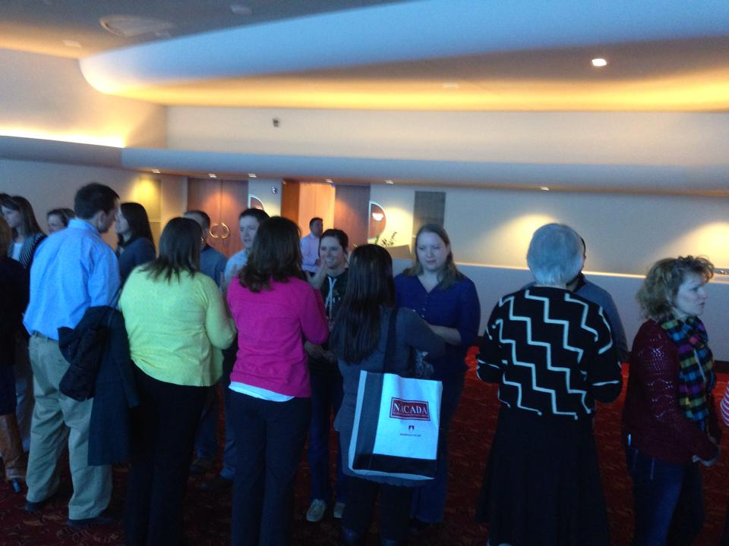
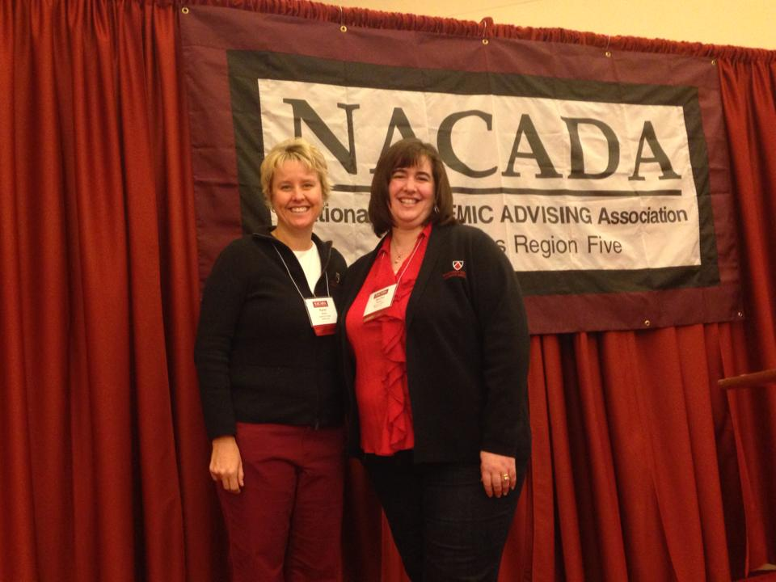
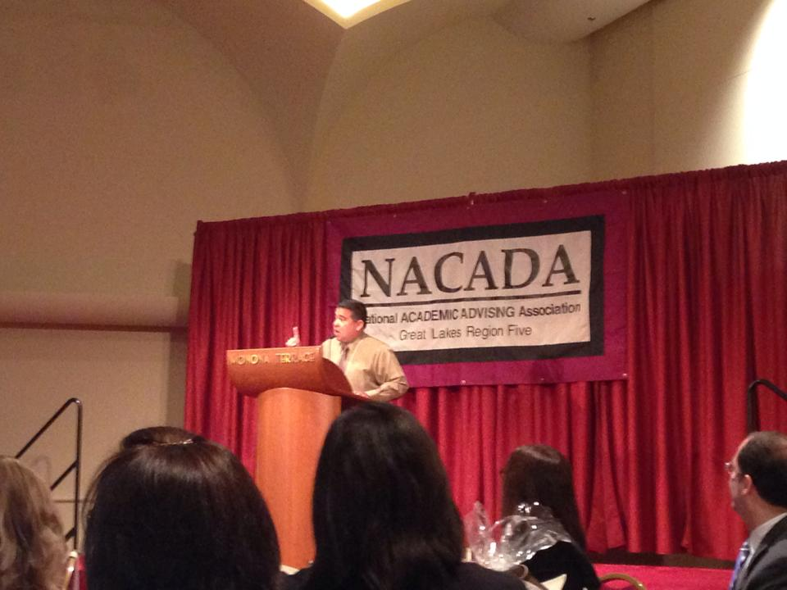
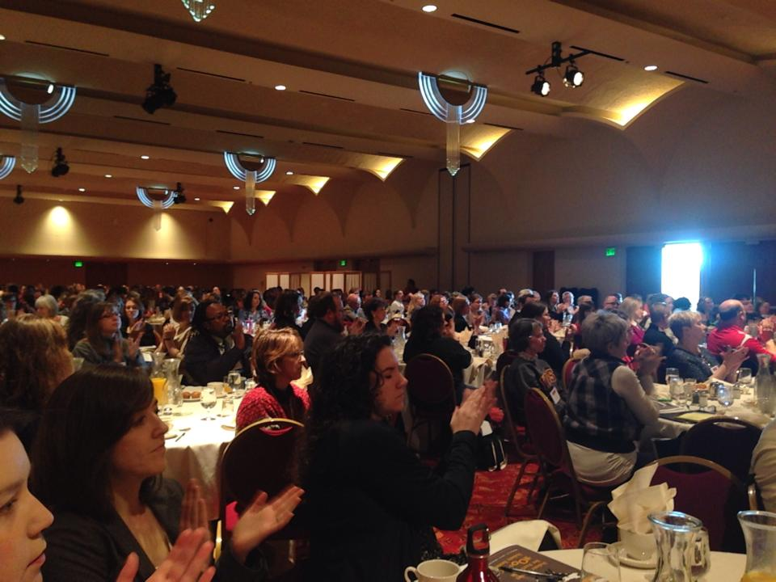

Slide 15
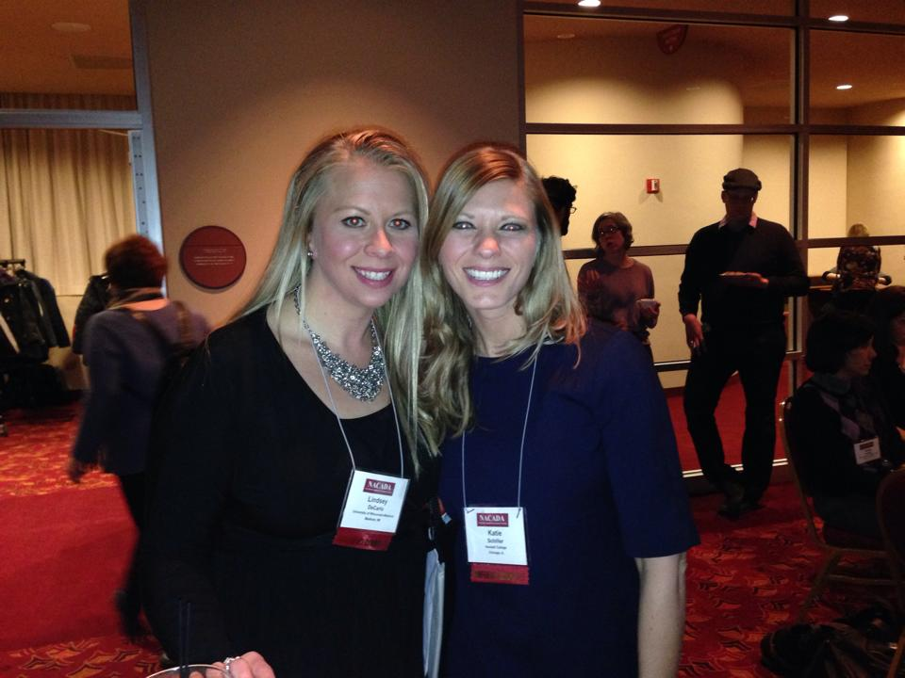
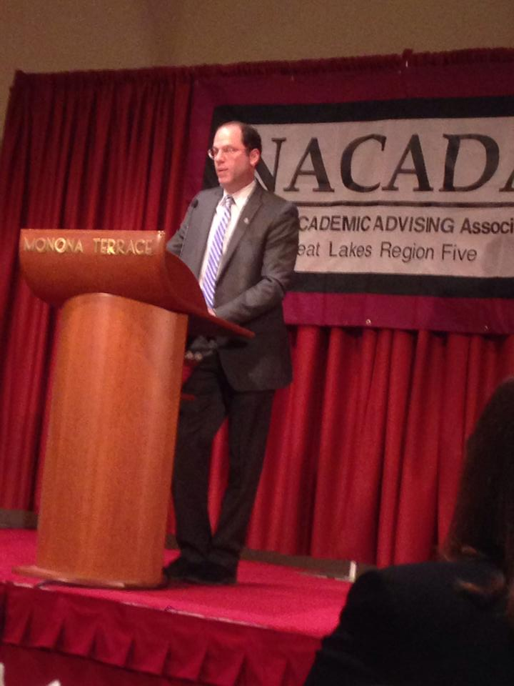
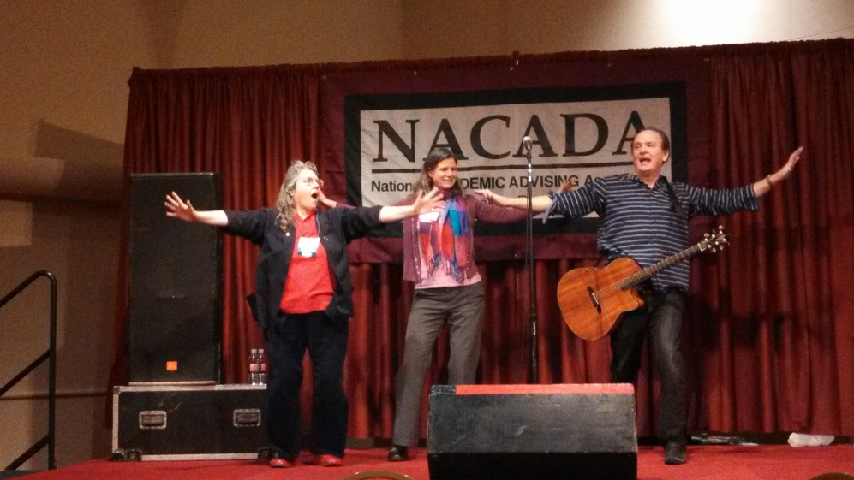
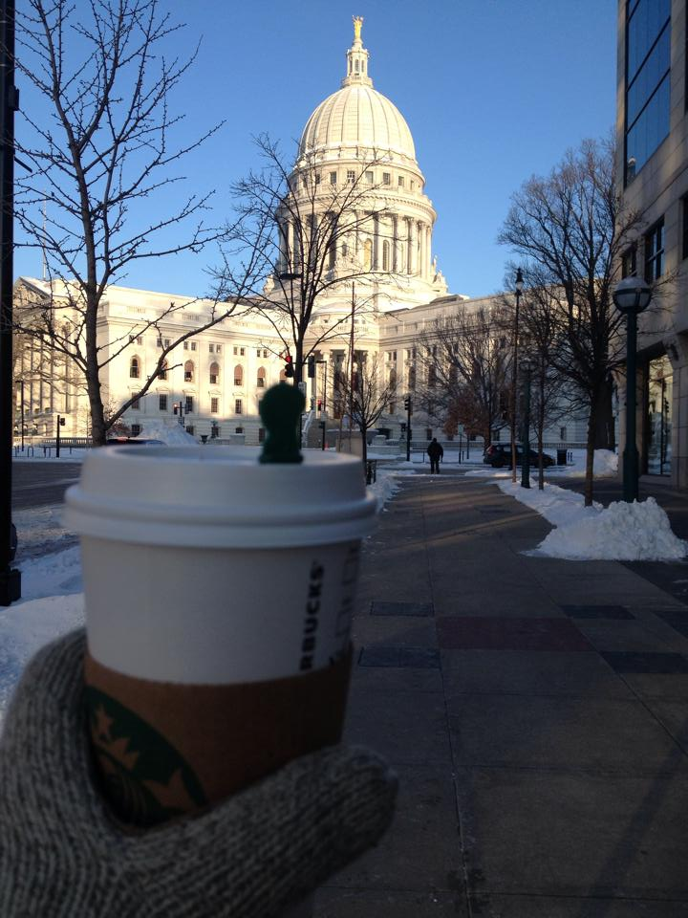
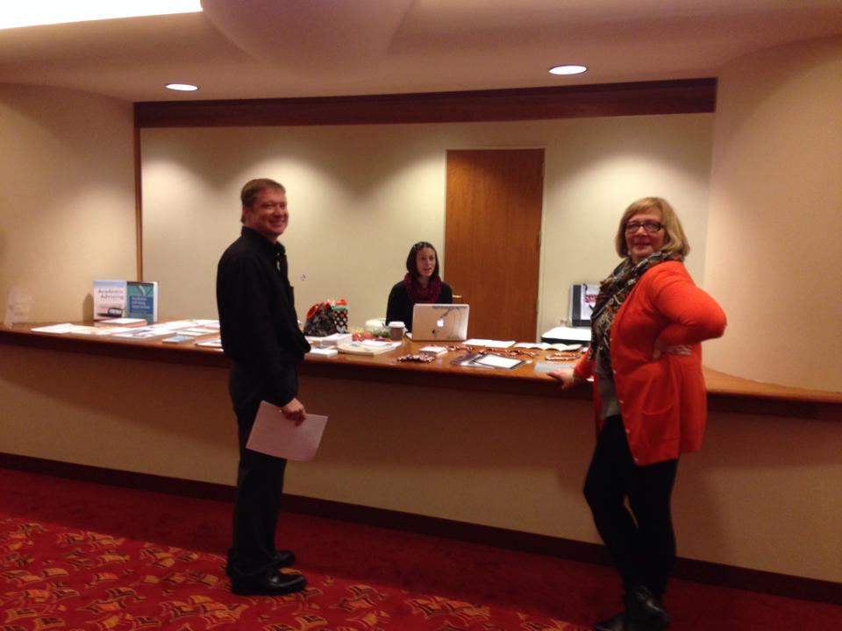

Slide 16


Slide 17

2015 NACADA Research Symposium
You’re in Indy anyway, so stick around ….
2015 NACADA Research Symposium at Region V
Friday, April 10 (starting after lunch) – Saturday, April 11 (ending mid-afternoon)
Come with an interesting topic and leave with a research plan!
Contact Wendy Troxel (wgtroxel@ilstu.edu) for details

Slide 18
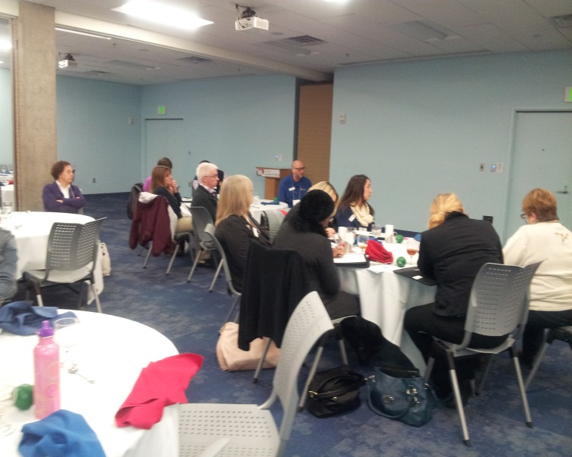
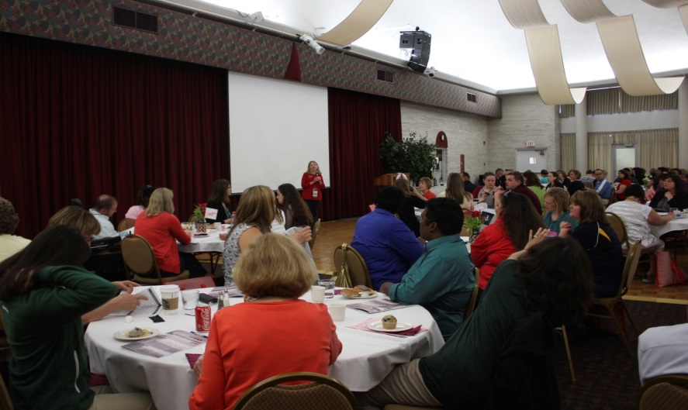
Providing Professional Development Opportunities at the State, Province and Institutional level
Through our Institutional and State Allied Organizations we have provided professional development opportunities to over 1000 academic advisors throughout the region!

Slide 19
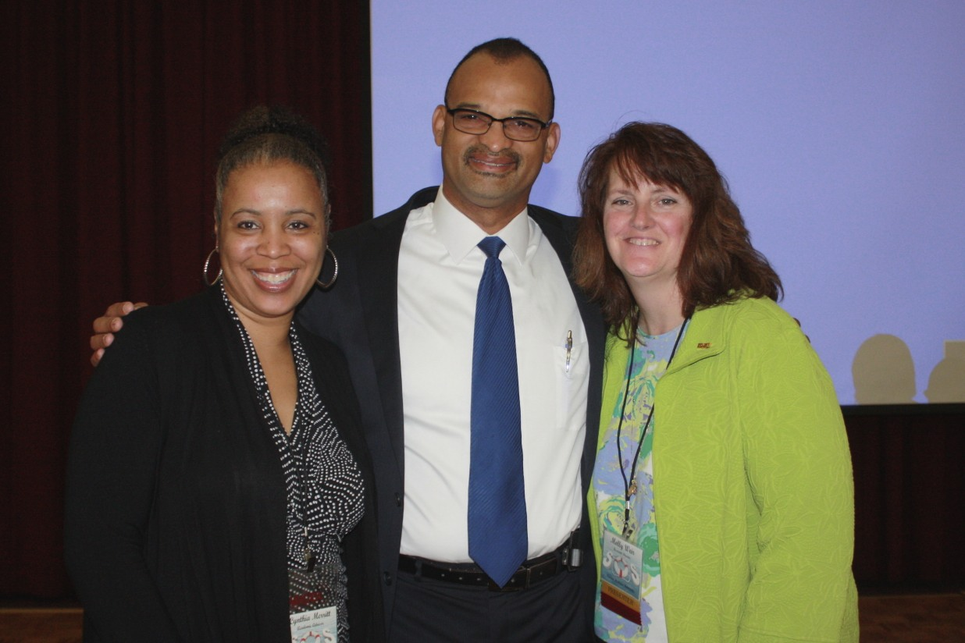
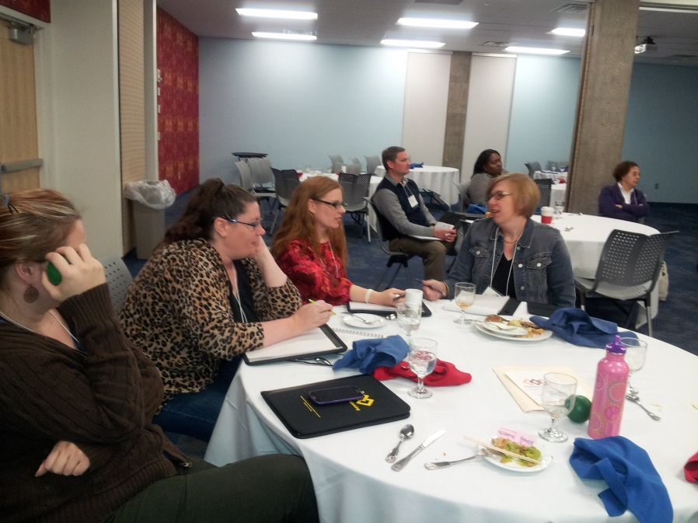
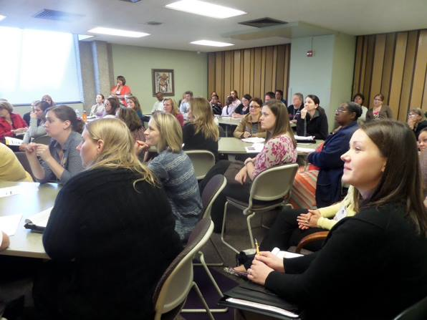
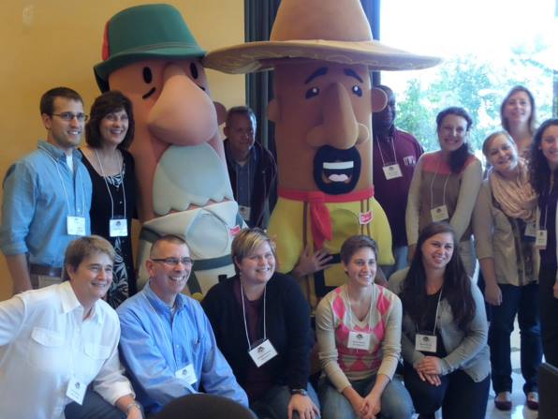
Providing Professional Development Opportunities at the State, Province and Institutional level

Slide 20
Congratulations to the 2014 NACADA Award Winners – Region V
Michael C. Holen Pacesetter Award
Douglas Estry – Michigan State University
Outstanding Advising Administrator
Kyle McCool – IUPUI
Shannon Esselink – Oakland University
Outstanding Advising Administrator Certificate of Merit
Mark Diekman – Purdue University

Slide 21
Congratulations to the 2014 NACADA Award Winners – Region V
Outstanding Advisor Primary Role
Kami Weis – University of Wisconsin-Stevens Point
Laura Masterson – IUPUI
Outstanding Advisor Primary Role –Certificates of Merit
Anneliese Kay – Purdue University
Cheryl Hutchins – Western Illinois University
Renee Ligeski – Oakland University

Slide 22
Congratulations to the 2014 NACADA Award Winners – Region V
Outstanding Advising Award – Faculty Academic Advising
Travis Nelson – University of Wisconsin-Platteville
Outstanding Advising Award – Faculty Academic Advising Certificate of Merit
Kathy Brady –University of Wisconsin-Whitewater

Slide 23
Congratulations to the 2014 NACADA Award Winners – Region V
Outstanding New Advisor –Primary –Certificate of Merit
Alejandra Lopez –University of Wisconsin –Milwaukee
Barbara Anderson – University of Illinois
Peter Vasher – Purdue University
Shannan Stryjewski – Indiana University
Outstanding Institutional Advising Program
Latin American Recruitment & Educational Services – University of Illinois at Chicago

Slide 24
Congratulations to the 2014 NACADA Scholarship Winners – Region V
Administrator’s Institute Scholarship
Cesar Jimenez - Morton College
Sheryl McGriff -University of Detroit - Mercy
Assessment Institute Scholarship
Shirley Bono- DePaul University
Wes R. Habley NACADA Summer Institute Scholarship
Rhonda Christian- Durham College

Slide 25
Congratulations to the 2014 NACADA Scholarship Winners – Region V
Student Research Award
John Gipson – Purdue University
Graduate Student Regional Conference Scholarship
Jessica Niedermayer - Mount Mary University
Jasmine Lee - Michigan State University
Jen Oza - Grand Valley State University
Cheng Tan - Grand Valley State University
Nicholas Woodward - Grand Valley State University
Tristin Cooper - Southern Illinois University - Edwardsville -

Slide 26
Congratulations to the 2014 NACADA Scholarship Winners – Region V
NACADA Research Symposium Scholarship
Brianne Lauka – Northern Illinois University
Graduate Student Annual Conference Scholarship
Theresa Lyon - Grand Valley State University
Chris Venable - Bowling Green State University

Slide 27
NACADA Emerging Leaders Program
2012-14 Class:
Bill Torgler, University of Akron (mentor)
Deb Dotterer, Michigan State University (mentor)
Jo Stewart, Brock University (mentor)
2013-15 Class
Kathy Stockwell, retired, Fox Valley Technical College (mentor)
Anita Carter, Wayne State University (mentor)
Michelle Ware, University of Notre Dame (leader)
2014-16 Class
Wiona Porath – Siena Heights University (leader)
Shannon Burton, Michigan State University (mentor)

Slide 28
Region V
Celebrating Our Success, Positioning us for the future….
Survey of award winners to see where the grants and scholarships have taken them.
Continuing to increase activity on social media
Continuing to promote leadership opportunities throughout the region and within the global community
Continuing to provide accessible professional development opportunities to advising professionals throughout the region.

